Slide 1
Novel Missense Mutation analysis for Genetics disorders
Khyber Shinwari
Ural Federal University
Department Immunochemistry

Slide 2
Description
A missense mutation is a DNA change that results in different amino acids being encoded at a particular position in the resulting protein. Some missense mutations alter the function of the resulting protein.
Missense mutations can render the resulting protein nonfunctional,^{[2]} and such mutations are responsible for human diseases such as Epidermolysis bullosa, sickle-cell disease, SOD1 mediated ALS, and a substantial number of cancers.
Not all missense mutations lead to appreciable protein changes. An amino acid may be replaced by an amino acid of very similar chemical properties, in which case, the protein may still function normally; this is termed a neutral, "quiet", "silent" or conservative mutation. Alternatively, the amino acid substitution could occur in a region of the protein which does not significantly affect the protein secondary structure or function. When an amino acid may be encoded by more than one codon (so-called "degenerate coding") a mutation in a codon may not produce any change in translation; this would be a synonymous substitution and not a missense mutation.

Slide 3
Frequency

Slide 4
Using Bioinformatics to understand Genetic disorders
What is role of bioinformatics in genetic diseases?
Apart from analysis of genome sequence data, bioinformatics is now being used for a vast array of other important tasks, including analysis of gene variation and expression, analysis and prediction of gene and protein structure and function, prediction and detection of gene regulation networks, simulation environments .
Why is bioinformatics important in genetic research?
Bioinformatics tools aid in the comparison of genetic and genomic data and more generally in the understanding of evolutionary aspects of molecular biology. At a more integrative level, it helps analyze and catalogue the biological pathways and networks that are an important part of systems biology.

Slide 5
Missense Mutation and genetics disorders
Proteins play a vital role in the regulation of various cellular functions, depending on their proper conformation in the cellular environment (Dill and MacCallum 2012). DNA variants known as single nucleotide polymorphisms (SNPs) have been known to introduce changes in the function of a gene (Cargill et al. 1999).
A distinct class of such SNPs, known as nonsynonymous single nucleotide polymorphisms (nsSNPs), present in coding regions lead to amino acid changes that may cause alterations in protein function and account for vulnerability to disease. SNPs that do not affect the function of the protein are known as tolerated SNPs. Therefore, it is essential to distinguish the deleterious nsSNPs from the tolerant nsSNPs to understand the molecular genetic basis of human disease as well as to assess and understand the pathogenesis of the disease (Wang et al. 2009).
Alterations and misfolding in protein structures due to nsSNPs lead to severe impairments that cause various diseases in humans (Chandrasekaran and Rajasekaran 2016; Thirumal Kumar et al. 2018a; Thirumal Kumar et al. 2018b; Valastyan and Lindquist 2014). Although most genetic variations in protein sequences are predicted to have very little or no effect on the function of the protein, some nsSNPs are known to be associated with the disease. These disease-related nsSNPs have adverse effects on the catalytic activity, stability, and interactions of the protein with other molecules. Thus, the identification of disease-associated nsSNPs is essential, and it will facilitate the elucidation of molecular mechanisms underlying a given disease (Sneha et al. 2017a; Zaki et al. 2017a).

Slide 6
The experimental approach would be highly time-consuming to analyze the likely impact on protein function due to non-synonymous SNPs as well as to understand the association between these nsSNPs and the disease (Zhernakova et al. 2009). Information about the protein sequence and structure as well as the biochemical severity of the amino acid substitution, which are bioinformatics-based approaches, facilitates understanding of the phenotypic prediction.

Slide 7
Methodology of Identification of Novel Missense mutations
As in genetics disorder are caused by the mutation of the genes so you take a specific gene of study disorder
You need to download the gene specific missense mutations from different online databases
Nowadays, genotype-to-phenotype associations in human diseases can be efficiently explored by accessing to mutation databases, such as NCBI dbSNPs, HGMD,2SwissVar,3COSMIC,4HuVarBase,5HUMSAVAR,6and ClinVar,7where information on pathogenic mutations are collected. The fact that missense mutations constitute the most common sequence alteration in Men-delian disorders overs a good starting point to understand the mechanisms of disease appearance due to amino acid variations in mutated proteins.

Slide 9
Several algorithms to predict functional damages of Missense mutations.
Pathogenicity can arise from missense mutations whenever mutated proteins alter their structural stability and, consequently, their function. The large array of examples of this kind has driven the implementation of several algorithms to predict functional damages due to amino acid substitutions.
In recent years, various computational approaches have been developed that predict the effect of nsSNPs using various machine learning algorithms, such as the Hidden Markov model (Shihab et al. 2013), naïve Bayes classifier (Adzhubei et al. 2010), support vector machines (Acharya and Nagarajaram 2012; Capriotti et al. 2008), and neural network (Bromberg and Rost 2007), etc. In the present study, we performed an in silico analysis using various computational algorithms to explore the possible relationships between genetic mutations and phenotypic variations similar to our previous reports (Agrahari et al. 2018a; Agrahari et al. 2018b; Mosaeilhy et al. 2017a; Mosaeilhy et al. 2017b; Zaki et al. 2017b). To increase in prediction accuracy of disease causing variants, we used Meta-SNP server (Capriotti et al. 2013) that integrates four existing methods: PANTHER, SIFT, PhD-SNP, and SNAP to predict a mutation either disease (affecting the protein function) or neutral (having no impact).

Slide 10
Protein 3D modeling and Missense mutations
We search for gene wild protein structure while abundance of structures that are currently available in the Protein Data Bank (PDB) and Alpha fold
Then predicated the mutant protein structure through different bioinformatics tools, Phyr2,
Knowledge of protein structure can be used to predict the phenotypic consequence of a missense variant. Since structural coverage of the human proteome can be roughly tripled to over 50% of the residues if homology-predicted structures are included in addition to experimentally determined coordinates, it is important to assess the reliability of using predicted models when analyzing missense variants. Accordingly, we assess whether a missense variant is structurally damaging by using experimental and predicted structures.

Slide 13
Molecular dynamic simulation and Missense mutations
Molecular dynamics simulations provide links between structure and dynamics by enabling the exploration of the conformational energy landscape accessible to protein molecules
Combination of these in silico tools and molecular dynamics studies in mutational analysis has been confirmed to be a dominant approach in understanding macromolecule behaviors and their microscopic interactions, allowing insights into the impact of mutations (Agrahari et al. 2019;
Molecular dynamics (MD) aid in understanding the significant changes in the macromolecular structures of proteins due to mutations at an atomic level. Various studies have been performed that show the influence of MDS in analyzing the effects of nsSNPs on protein structure (George Priya Doss and NagaSundaram 2012;

Slide 14
Candidate variant filtrations
What is a variant filter?
Variant filtering is a secondary NGS analysis step that consists of identifying highly confident variants and removing the ones that are falsely called. The variant filtering step used to be mostly left out from deeper testing, even though it can has been shown to significantly improve precision of variant calls
What is variant calling? Variant calling is the process by which we identify variants from sequence data (Figure). Carry out whole genome or whole exome sequencing to create FASTQ files. Align the sequences to a reference genome, creating BAM or CRAM files

Slide 16
Novel High-risk Missense Mutations identification in FAT4, TCGIR1 Genes causing Hennekam Syndrome and Van Maldergem Syndrome 2, Congenital Neuthropnia through Molecular Dynamics Simulation
The NCBI dbSNP database had the highest missense nsSNPs (3434), then HGMD (16), ClinVar (130), and DisGeNET databases (20). Only two nsSNPs (F475L, E486Q) of the human FAT4 gene were not detected in the databases above mentioned. Still, the nsSNPs were characterized in the literature as they connected with Van Maldergem Syndrome 2 (2375K, C4159F, C4398Y) and HKLLS2 (F475L, E486Q, 2375K, and S4282F)

Slide 17
nsSNPs ID | Position of AA | SIFT | Score | PolyPhen-2 | Score | MAF
rs147663284 | D2978G | Low Deleterious | 0.005 | Probably damaging | 0.99
rs192514171 | V986D | Low Deleterious | 0 | Probably damaging | 1.00
rs138137489 | Y1912C | Low Deleterious | 0.001 | Probably damaging | 1.00
rs199895179 | R4799C | Low Deleterious | 0 | Probably damaging | 1.00 | <0.001 (T)
rs372060616 | D1022G | Low Deleterious | 0 | Probably damaging | 1.00
rs138173652 | G4786R | Low Deleterious | 0 | Probably damaging | 1.00 | <0.001(A)
rs142184187 | D2439E | Low Deleterious | 0 | Probably damaging | 0.99
rs147633644 | E2426Q | Low Deleterious | 0 | Probably damaging | 1.00
rs181607904 | R4643C | Low Deleterious | 0 | Probably damaging | 1.00 | <0.001 (T)
rs184971791 | N1309I | Low Deleterious | 0 | Probably damaging | 0.99
rs148655455 | Y2909H | Low Deleterious | 0 | Probably damaging | 1.00

Slide 18
Protein modeling of FAT4 and TCGIR1
The protein 3D model was predicted by HHpred, Phyre2 and AlphaFold2 while the wild-type structure was predicted by AlphaFold2 available in uniport with Q13488 ID. The mutant structures predicted by HHpred and proceed with MD Simulation and similarly, the structure of mutant was also predicted by Alphafold2 and also proceed for 100ns MD simulation for further analysis and validation

Slide 19
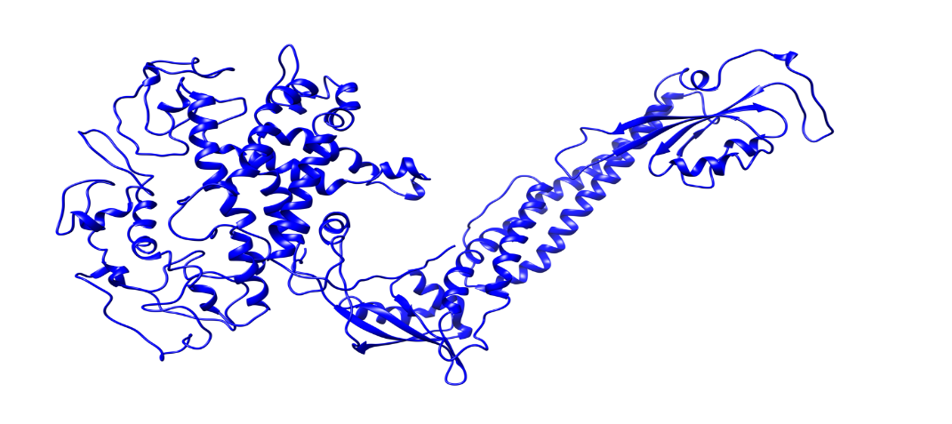
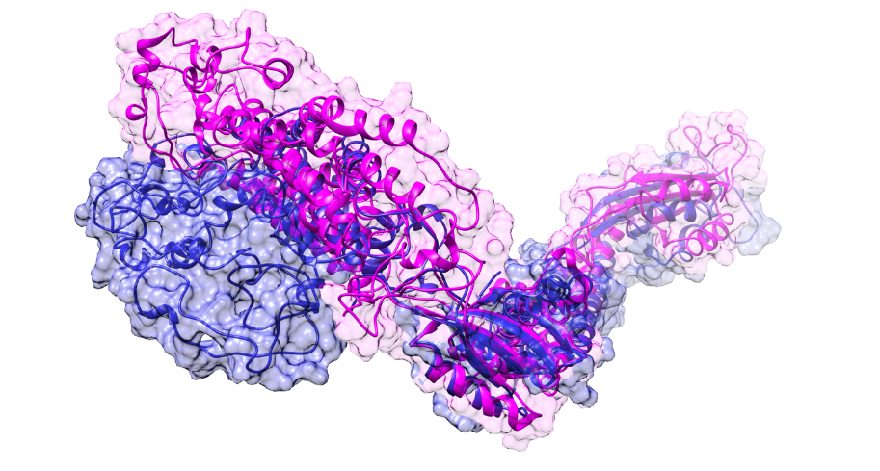
3D structure of wild type protein predicted by AlphaFold2, Fig7 b: 3D predicted structure of Mutant protein, Fig7 c: superimposition of 3D structure of Mutant (blue) and Wild Type Magenta

Slide 20
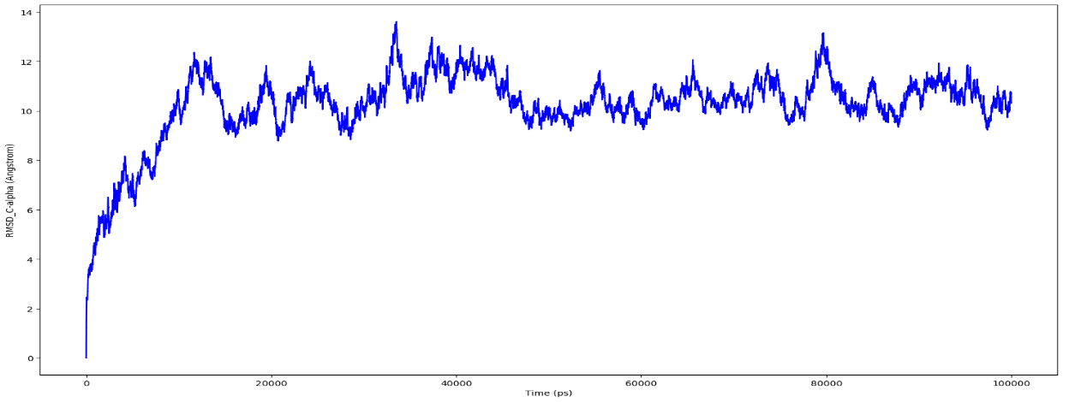
Figure 8: Root mean square deviation (RMSD) of the C-alpha atoms of Wild Type (A) and Mutant by HHpred (B) and Mutant by Alphafold2 (C) with time. The left Y-axis shows the variation of proteins RMSD through time.
A

Slide 21
Figure 7: The total energy of Model 1 & 2Wild Type Protein and Mutant Protein

Slide 22
Figure 8: Radius of gyration of Wild Type Protein and Mutant Protein of Model 1 & 2.

Slide 23
Conclusion
Such studies can emphasizes the importance of these computational approaches for the classification and interpretation of mutants that can make the process of designing personalized medicine less complicated for treatment of the disease caused by a particular mutation. Computational biology in recent years has developed the potential to speed up the drug discovery process. Identifying deleterious nsSNPs may also help in elucidating the pattern of the disease and drug response.
Most of the 11 high-risk deleterious nsSNPs and mutations identified through candidate variant analysis disrupt the structure and function of the FAT4 protein. As from literature and databases we have found that only two FAT4 mutations are published for Hennekam syndrome (S4282F, E2375K), and three for VMS2 (C4159F, E2375K, C4398Y). Since these mutations found in our study are novel and have not been reported in the FAT4 gene, we proved using Insilco methods, how these missense mutations can destabilize protein structure and function. In a dynamic molecular simulation experiment, we used all of these mutations, five published, 11 newly predicted, and three mutations identified in the patient. According to the results of the molecular simulation study, each of the mutations had an effect on the structure stability of the FAT4 protein.
In Hennecam syndrome, disruption of the structure of lymph vessels, leading to lymphoedema, plays an important role in the pathogenesis of the disease. On this basis, it is likely that destabilizing mutations will have a more negative effect on the clinical condition of the patient than stabilizing ones. On the other hand, the FAT4 molecule is very long, and stabilizing the structure at one site combined with destabilizing it at another may also lead to abnormalities.

Slide 24
The outcomes of our study will facilitate future genome association studies in distinguishing deleterious SNPs associated with different individual patients with HS. Therefore, to define this SNP data, extensive clinical trial-based research on a large population is needed, as well as experimental mutational studies to validate the results. Combining several in-silico methods could add numerous dimensions to predicting the impact of mutations on proteins, resulting in a cost-effective and quick screening tool for directing diagnostic and experimental procedures. On the other hand, in-silico instruments cannot substitute conclusive research, and their findings must be backed up by biological evidence.

Slide 25
References
Acharya V, Nagarajaram HA (2012) Hansa: an automated method for discriminating disease and neutral human nsSNPs. Hum Mutat 33:332–337. https://doi.org/10.1002/humu.21642
Adzhubei IA, Schmidt S, Peshkin L, Ramensky VE, Gerasimova A, Bork P, Kondrashov AS, Sunyaev SR (2010) A method and server for predicting damaging missense mutations. Nat Methods 7(4):248–249
Worth CL, Preissner R, Blundell TL (2011) SDM—a server for predicting effects of mutations on protein stability and malfunction. Nucl acids res 39(web server issue):W215–W222
Tanwar H, Kumar DT, Doss CGP, Zayed H. Bioinformatics classification of mutations in patients with Mucopolysaccharidosis IIIA. Metab Brain Dis. 2019 Dec;34(6):1577-1594. doi: 10.1007/s11011-019-00465-6. Epub 2019 Aug 5. PMID: 31385193; PMCID: PMC6858298.
Shinwari K, Rehman HM, Liu G, Bolkov MA, Tuzankina IA, Chereshnev VA. Novel Disease-Associated Missense Single-Nucleotide Polymorphisms Variants Predication by Algorithms Tools and Molecular Dynamics Simulation of Human TCIRG1 Gene Causing Congenital Neutropenia and Osteopetrosis. Front Mol Biosci. 2022 Apr 28;9:879875. doi: 10.3389/fmolb.2022.879875. PMID: 35573728; PMCID: PMC9095858.
Li M, Petukh M, Alexov E, Panchenko AR. Predicting the Impact of Missense Mutations on Protein-Protein Binding Affinity. J Chem Theory Comput. 2014 Apr 8;10(4):1770-1780. doi: 10.1021/ct401022c. Epub 2014 Feb 27. PMID: 24803870; PMCID: PMC3985714.
Bongini P, Gardini S, Bianchini M, Spiga O, Niccolai N. Structural bioinformatics survey on disease-inducing missense mutations. J Bioinform Comput Biol. 2021 Jun;19(3):2150008. doi: 10.1142/S0219720021500086. Epub 2021 Apr 22. PMID: 33888033

Slide 26
Thanks

